Slide 1
GENAI call presentation & Q&A session
…………………………….…… We are about to start …………………………………
PLEASE shut down your mike
Ask your questions in the chat, add slide number
The session will be recorded and available on our website

Slide 2
GENAI call presentation &
Q&A session
Jan 31st, 2025
Jonathan Duplicy

Slide 3
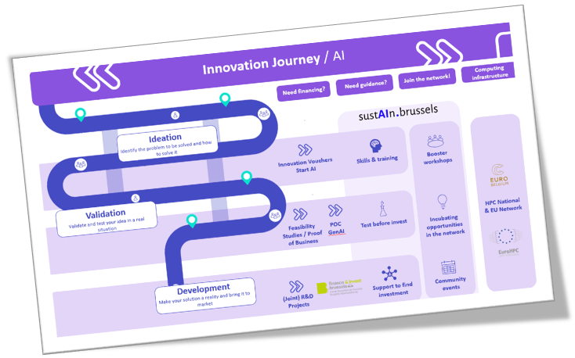
Context : AI strategy Innoviris

Slide 4
Two documents
https://www.innoviris.brussels/program/genai

Slide 5
Accelerating the integration of generative AI
into the Brussels economy

Slide 6
Objectives
Feasibility study + POC
Products
Services
Processes
Duration <= 10 months

Slide 7
Feasibility Study
Is genAI the most appropriate solution for the problem at hand?
Which models or types of models are most appropriate ? What level of dependence on the chosen model is acceptable? How will the model be maintained and updated?
Is the available data sufficient, representative, and unbiased?
How will the confidentiality, security and compliance (GDPR...) ensured?
How will the solution be tested? What minimum level of performance is required?
Can the solution 'scale'? What technical infrastructure is envisaged?
….

Slide 8
Feasibility Study (con’t)
What are the costs and revenues associated with the GENAI solution? Is the expected return on investment satisfactory?
How will the generated content (text, image, code, ...) be treated in terms of ownership or liability?
What are the technical, operational, and strategic risks associated with the solution? How will ethical and reputational risks be managed?
….

Slide 9
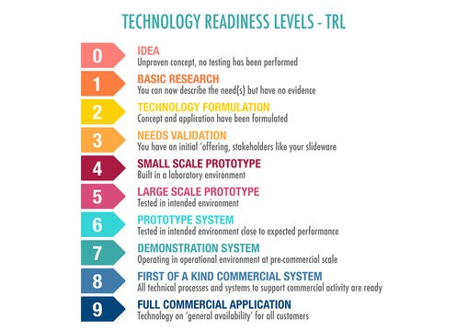
Proof-of-Concept
Prototype tested in intended environnement

Slide 10
Examples
! A minimum degree of contextualization and customization required
Hyper-personalization: offering based on individual preferences
New user interfaces: transform the way people interact with SW
Scaling: new offerings, new markets swiftly
Customer service: addressing complex needs from customers
Internal efficiency gains: automate tasks, reduce errors
…

Slide 11
Eligibility
Be a company with activities (of the project) in BXL
Not be in financial difficulty
Demonstrate the incentive effect of the aid
Not already receiving public support for the tasks included in the project (prohibition of double funding)

Slide 12
Financing terms
Maximum budget: 80.000€
Funding rates:
Small Company | 70%
Medium Company | 60%
Large Company | 50%
Company category | Staff headcount | Turnover | or |  | Balance sheet total
Medium | < 250 | ≤ € 50M |  | ≤ € 43M
Small | < 50 | ≤ € 10M |  | ≤ € 10M

Slide 13
Financing terms: payment
50% at start
50% at the end provided:
Scientific report (= answer to questions)
Demo of PoC
Cost Claim

Slide 14
Eligible costs
Personnel costs (employee or self-employed)
Capital costs: depreciation only!
Operating expenses: including costs related to licenses and cloud services.
Subcontracting costs:
max 2/3 of the budget
plan to eventually internalize the skills
offer from subcontractor to be joined to the file
a company can be a subcontractor for several projects

Slide 15
Scheduling
Cut Off #1 | March 20, 2pm
Cut Off #2 | June 13, 2pm

Slide 16
Evaluation
Criteria:
Innovative character
Implementation: methodology, expertise, …
Strategic and economic impact
Societal enhancement: social or environmental
In practice: eligible project promoters will be invited for a max-1h video-conf discussion

Slide 17
Free guidance through sustain.brussels

Slide 18
Our Mission
As a European Digital Innovation Hub, we guide Brussels companies toward sustainable digital innovation, focusing on AI and emerging technologies.
Our services are free of charge.

Slide 19
Test before invest Limited individual sessions
Skills & Training
Innovation networking and ecosystems
Support to investments/funding
Find your digital & sustainable journey
Proof of concept
Access to labs
Guidance to mature digital offering
Guidance towards impact investments or funding
Meet your investor
Monthly Sustain Brussels AI Happy Hour
18/6 and 19/6 GreenTech Forum Brussels (Annual event)
Training tracks
Masterclasses
Train the trainers
Learning Network
4 PILLARS

Slide 20
Sustain.brussels support for GENAI applications
We assist you in your AI journey.
Helping you -Define questions
-Scope the PoC
Track 1
20 March deadline
Track 2
STARTIA
13 June deadline

Slide 21
CONTACT :
Yavuz SARIKAYA
yavuz.sarikaya@ulb.be Digital platform & sustainability Advisor

Slide 22
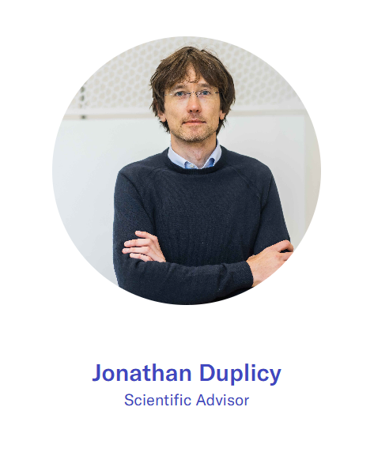
Contact
jduplicy@innoviris.brussels

Slide 23
Q&A Session

